Slide 1

Week 3: Linked Bag Implementation
CS/COE 0445 - Data Structures
Sherif Khattab
http://www.cs.pitt.edu/~skhattab/cs0445
(Some slide contents are © 2016 Pearson Education, Ltd. All rights reserved.
Others are from Dr. Ramirez’s CS 445 course)

Slide 2
Administrivia
Assignment 1 due on Monday Jan. 29 @11:59pm
Quiz 1 in recitations of next week
Open book, notes, and Internet
Design and implement a small program
Check the post-lab follow-up questions!
Prepare for the lab by going over the pre-lab part
Top Hat:
Please register as soon as possible; let me know if you have any concerns
Change your email address to your formal (<username>@pitt.edu), not the aliases

Slide 3
Earlier in the course
Java interfaces and generics
Fixed-size and resizable array implementations of the Bag ADT

Slide 4
This Week’s Topics
Using the Bag ADT
Linked implementation of the Bag ADT
Performance analysis and comparison of Array-based and Linked implementations of the Bag ADT

Slide 5
Using a Bag
A Bag is a simple ADT, but it can still be useful
See examples in text
Here is another simple one
A number of players “shout” Snap! each with a certain probability.
Add the player number to a Bag if she shouts.
Count the number of shouts in the Bag.

Slide 6
Pros and Cons of Using an Array
Adding an entry to the bag is fast
Removing an unspecified entry is fast
Removing a particular entry requires time to locate the entry
Increasing the size of the array requires time to copy its entries
© 2016 Pearson Education, Ltd. All rights reserved.

Slide 7
Problems with Array Implementation
Array has fixed size
May become full
Alternatively may have wasted space
Resizing is possible but requires time overhead

Slide 8
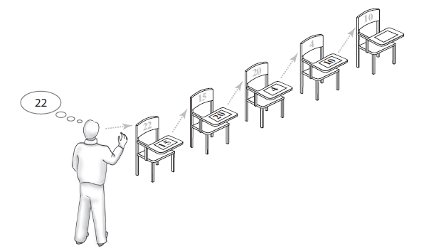
Linked Chain Implementation
A chain of five desks

Slide 9
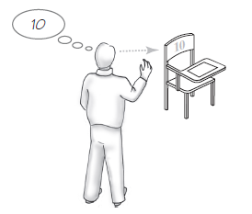
Forming a Chain
One desk in the room

Slide 10
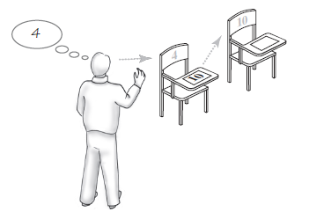
Forming a Chain
Two linked desks, with the newest desk first

Slide 11
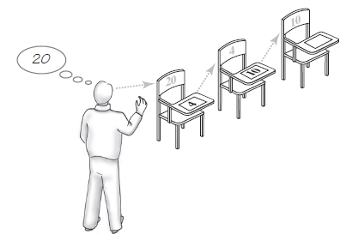
Forming a Chain
Three linked desks, with the newest desk first.

Slide 12
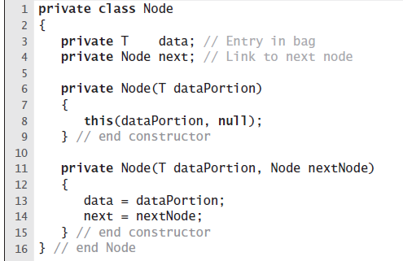
The Private Class Node
The private inner class Node

Slide 13
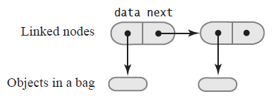
The Private Class Node
Two linked nodes that each references object data

Slide 14
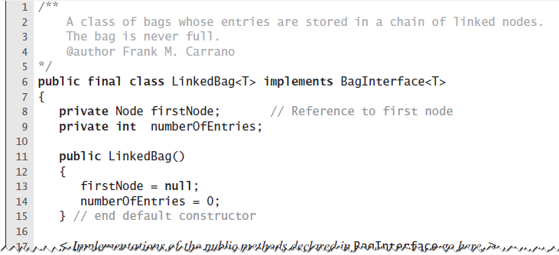
Class LinkedBag

Slide 15
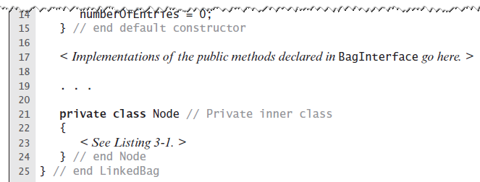
Class LinkedBag

Slide 16
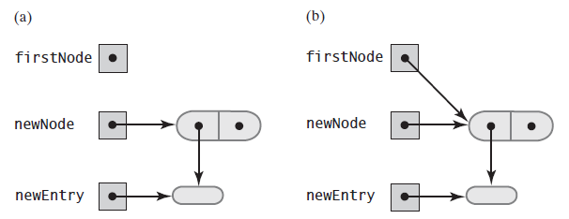
Beginning a Chain of Nodes
(a) An empty chain and a new node; (b) after adding a new node to a chain that was empty

Slide 17
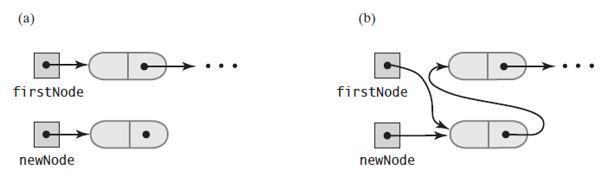
Beginning a Chain of Nodes
A chain of nodes (a) just prior to adding a node at the beginning; (b) just after adding a node at the beginning

Slide 18
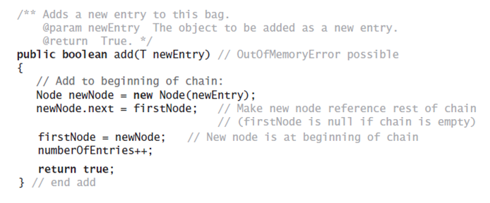
Beginning a Chain of Nodes
The method add

Slide 19
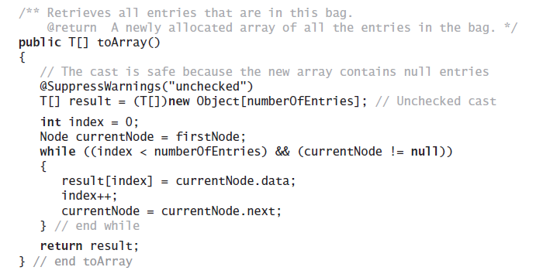
Method toArray
The method toArray returns an array of the entries currently in a bag

Slide 20
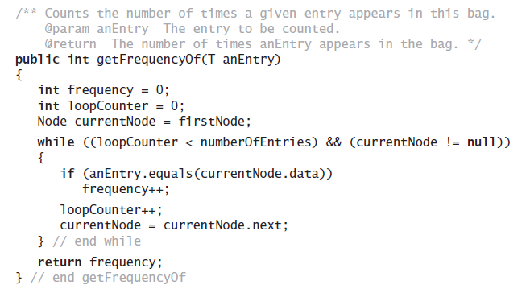
Method getFrequencyOf
Counts the number of times a given entry appears

Slide 21
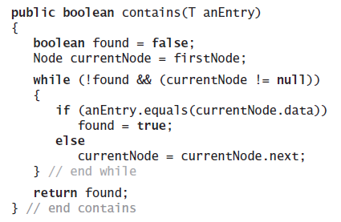
Method contains
Determine whether a bag contains a given entry

Slide 22
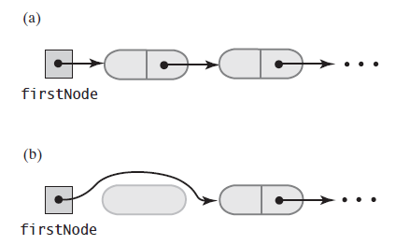
Removing an Item
A chain of nodes (a) just prior to removing the first node; (b) just after removing the first node

Slide 23
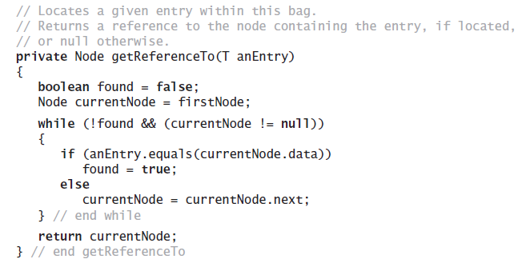
Method remove
Note need for private method getReferenceTo

Slide 24
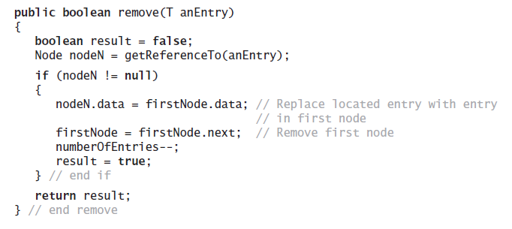
Method remove
Note use of method getReferenceTo

Slide 25
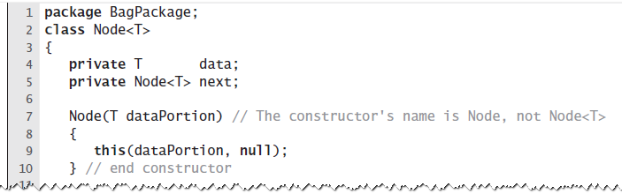
A Class within A Package
The class Node with package access

Slide 26
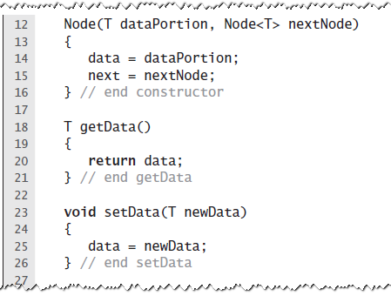
A Class within A Package

Slide 27
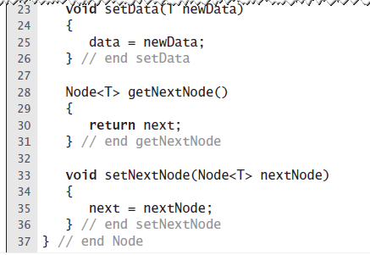
A Class within A Package

Slide 28
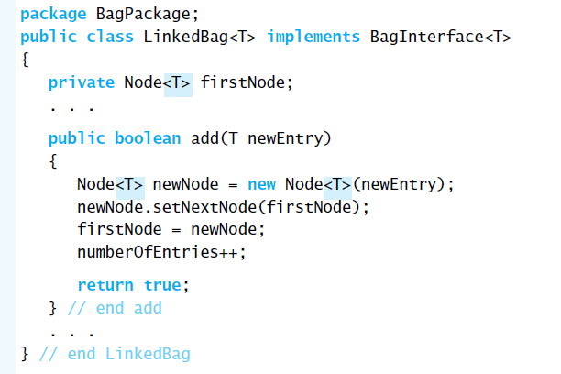
When Node Is in Same Package
LISTING 3-6 The class LinkedBag when Node is in the same package
This occurrence of T is optional

Slide 29
Pros of Using a Chain
Bag can grow and shrink in size as necessary.
Remove and recycle nodes that are no longer needed
Adding new entry to end of array or to beginning of chain both relatively simple
Similar for removal

Slide 30
Cons of Using a Chain
Removing specific entry requires search of array or chain
Chain requires more memory than array of same length

Slide 31
Why Efficient Code?
Computers are faster, have larger memories
So why worry about efficient code?
And … how do we measure efficiency?

Slide 32

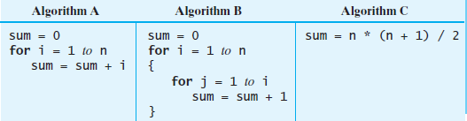
Example
Consider the problem of summing
Three algorithms for computing the sum 1 + 2 + . . . + n for an integer n > 0

Slide 33
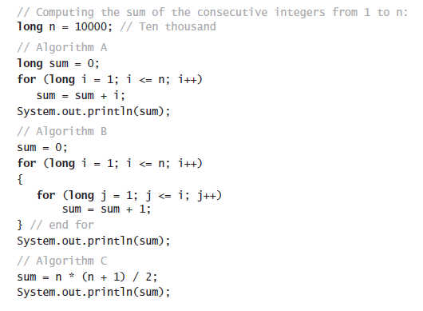
Example
Java code for the three algorithms

Slide 34
What is “best”?
An algorithm has both time and space constraints – that is complexity
Time complexity
Space complexity
This study is called analysis of algorithms

Slide 35
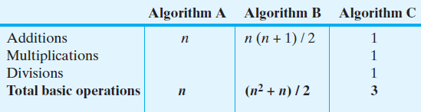
Counting Basic Operations
A basic operation of an algorithm
The most significant contributor to its total time requirement
The number of basic operations required by the sum algorithms

Slide 36
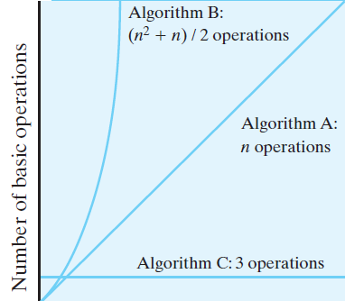
Counting Basic Operations
The number of basic operations required by the sum algorithms as a function of n

Slide 37
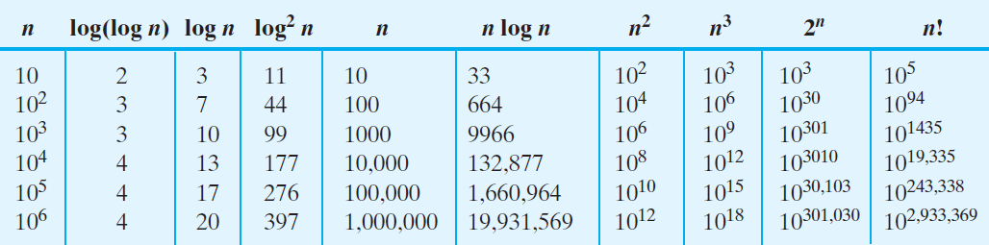
Counting Basic Operations
Typical growth-rate functions evaluated at increasing values of n

Slide 38
Best, Worst, and Average Cases
For some algorithms, execution time depends only on size of data set
Other algorithms depend on the nature of the data itself
Here we seek to know best case, worst case, average case

Slide 39
Big Oh Notation
A function f(n) is of order at most g(n)
That is, f(n) is O(g(n))—if
A positive real number c and positive integer N exist …
Such that f(n) ≤ c * g(n) for all n ≥ N
That is, c * g(n) is an upper bound on f(n) when n is sufficiently large

Slide 40
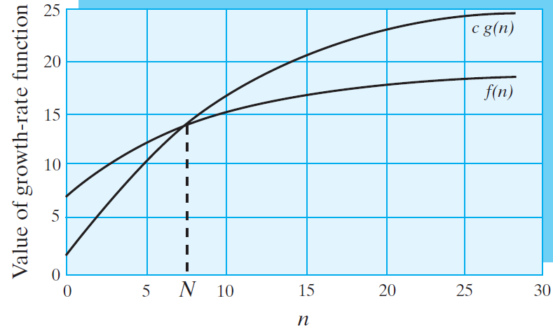
Big Oh Notation
An illustration of the definition of Big Oh

Slide 41
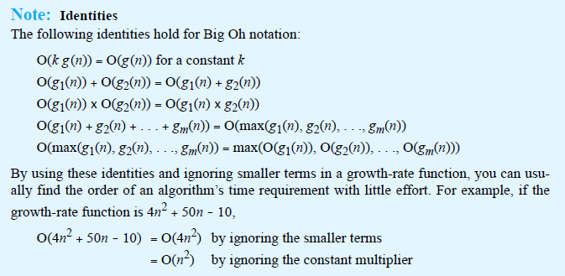
Big Oh Notation
Identities for Big Oh Notation

Slide 42
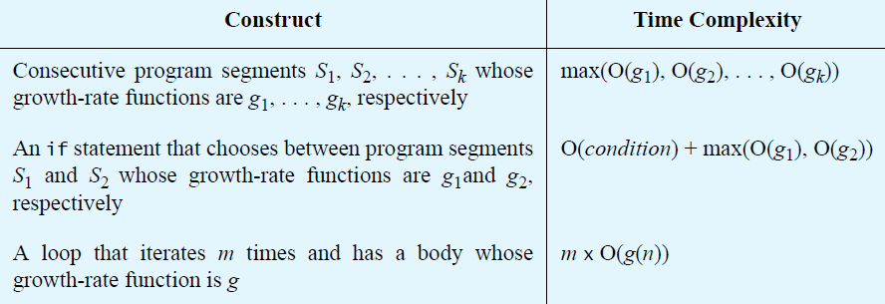
Complexities of Program Constructs

Slide 43
Time complexity of an algorithm
Count the number of executed steps (basic operations or just lines)
sum = 0
for i = 1 to n
sum = sum + i
Number of executed lines is 2n + 2
Let f(n) = the number of executed steps
n is the problem size
Usually it is the input size (very roughly, the number of keyboard presses needed to enter the input)
f(n) may depend only on n or on the actual values of the input
In the latter, need to find f(n) for best, average, worst cases

Slide 44
Time complexity of an algorithm
Convert the function f into the Big-Oh notation
Ignore lower order terms
e.g., constant < log log n < log n < log²n < n < n log n < n² < n³ < 2^{n} < n!
e.g., n² + log n = O(n²)
Ignore constant factors
cn => O(n), where c is a constant (doesn’t depend on n)
2^{cn} is not O(2^{n})
f(n) = 2n + 2 = O(2n) = O(n)

Slide 45
The Big-Oh Family
Big Omicron: O ≈ <=
n = O(n)
n = O(n!)
Little Omicron: o ≈ <
n ≠ o(n)
n = o(n²)
Big Omega: Ω ≈ >=
n = Ω(n)
2^{n} = Ω(n)
Little Omega: ω ≈ >
n ≠ ω(n)
n = ω(1)
Theta: θ ≈ =
5n = θ(n) (has to be O and Ω)

Slide 46
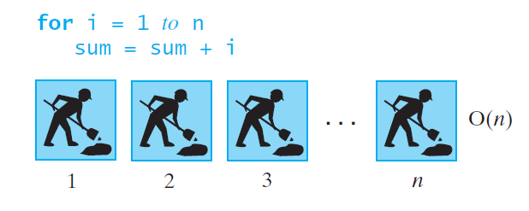
Picturing Efficiency
An O(n) algorithm

Slide 47
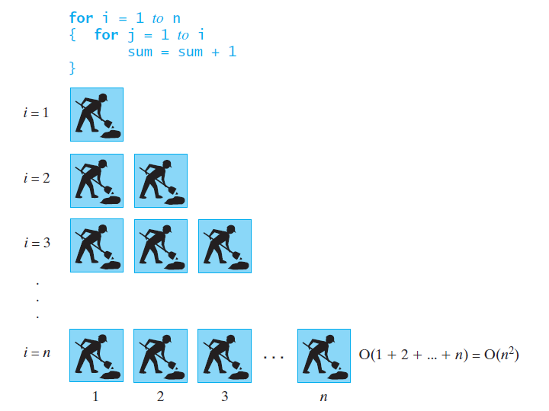
Picturing Efficiency
An O(n²) algorithm

Slide 48
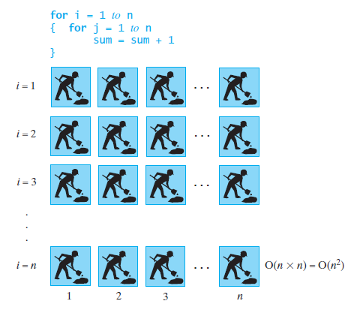
Picturing Efficiency
Another O(n²) algorithm

Slide 49
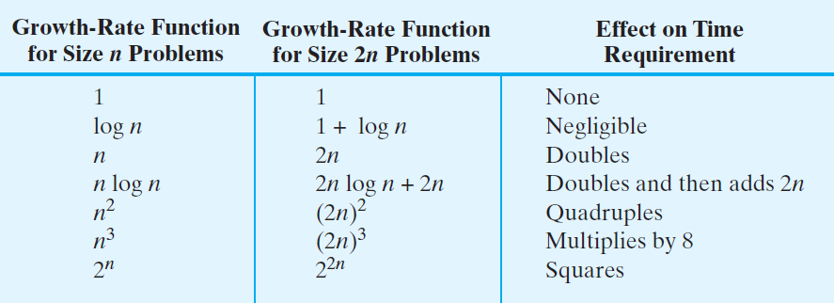
Picturing Efficiency
The effect of doubling the problem size on an algorithm’s time requirement

Slide 50
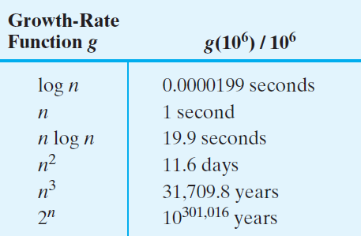
Picturing Efficiency
The time required to process one million items by algorithms of various orders at the rate of one million operations per second

Slide 51
Riding Moore’s law
Writing an efficient algorithm (with less time complexity) is important
Such algorithm rides the exponentially-growing curve of hardware-speed ``better”
Problem size solvable by machine M using Algorithm B in T second
Problem size solvable by machine M using Algorithm A in T second
Number of operations that machine M can do in time T seconds

Slide 52
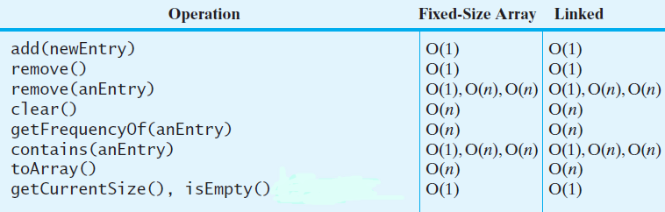
Efficiency of Implementations of ADT Bag
The time efficiencies of the ADT bag operations for two implementations, expressed in Big Oh notation

